Slide 1



Server-Side Web Technologies
Parwez neeamuth

Slide 2
Agenda
Internet
URL
Example of web Application
Web Programming
Client Server Architecture
World Wide Web

Slide 3

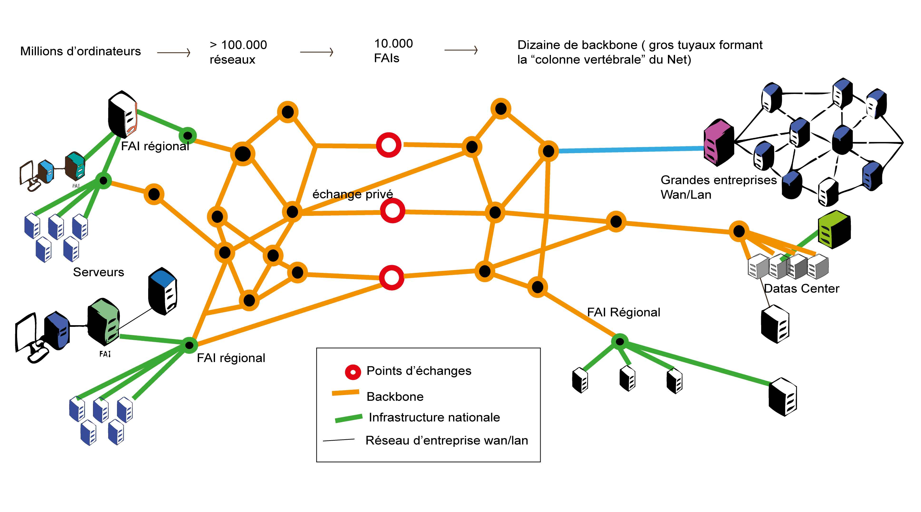
Internet
Collection of networks
Thousands of interconnected networks around the world
Which are based on different technologies.
Comprises servers, routers, and fiber optics cables.
Connected via the public backbone and
Communicating across networks using TCP/IP network protocols to facilitate data transmission and exchange.
This Photo by Unknown Author is licensed under CC BY-SA

Slide 4
Evolution of internet and World wide web
Arpanet
Established in late 1960’s by US Department of Defense.
To facilitate research among research Institutions
Birth of the World Wide Web
Invented by Tim Berners Lee in 1989
Revolutionized information sharing.
Leading to the creation of websites and hyperlinks.
Global Connectivity
Connected billions of people worldwide
Exponential growth – Revolutionizing communication, commerce and information sharing worldwide.

Slide 5
Evolution of today’s Internet
Pre-Internet
Human to human
Fixed line telephones
Internet of Content
Computers
Internet of Services
Web 2.0
Internet of People
Internet of Things
Postal Services
E-Commerce
Smart Phones and Applications
Social Media
Skype
Facebook
YouTube
Machine to Machine
Identification
Tracking
Monitoring
Metering
Automation
Smart Devices
Networks
Internet
World Wide Web
Browsers
Search Engines
Contents or Information
Blockchain

Slide 6
World wide web
The Web is an application (website) running on the Internet.
It is a collection of interconnected documents (web pages) and services maintained on the Internet
The web pages are stored in web servers and made accessible to client computers through the internet.
Computers reading the Web pages are called Web clients.
Web clients use a program called a Web browser to view the web pages.
The web browser can interact with several different kinds of servers
Web pages can be accessed either by:
Typing the URL (Uniform Resource Locator) of the page into a web browser
Following a hyperlink to that page or resource.

Slide 7
Impact of the World wide web
Revolutionized information access.
Facilitated E-commerce.
Transformed Social Networking
Enabled online education
Changed the way information is accessed, shared and consumed
Enabled the growth of online businesses and digital transactions.
Changed the dynamics of how people connect and interact online.
Provided opportunities for remote learning and skills development.

Slide 8
Challenges of the world wide web
Cybersecurity threats
Includes hacking, data breaches, and malware, necessitating proactive security measures.
Privacy concerns
Growing concerns about user consent, data collection, and the ethical use of personal information.
Misinformation
Proliferation of misinformation on the internet.
Requires strategies to promote media literacy and fact-finding
Digital Divide
Creating disparities in internet access and digital skills
Need inclusive connectivity and digital literacy initiatives

Slide 9
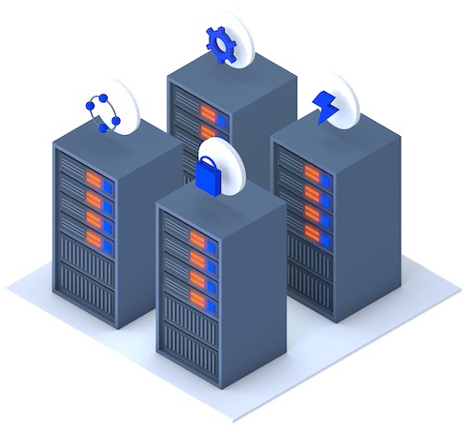
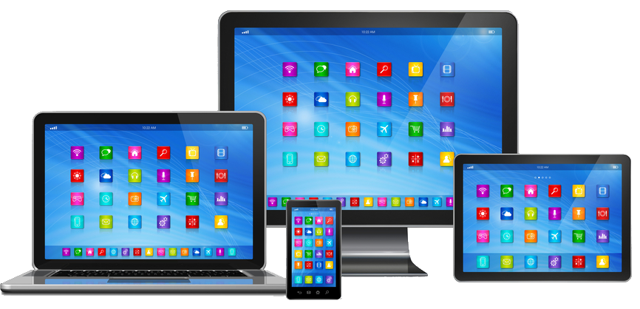

Client server architecture
The client computer sends a request for information to the server through the internet.
The server accepts the requested, process it and deliver the requested information back to the client
Client
HTTP Request
Server
HTTP Response

Slide 10
Key components of client-server architecture
Clients and Servers
Consists of clients (end-user devices) and servers (Computing resources) as the primary components.
Network infrastructure
Facilitates communication between clients and servers
Protocols and communication standards
To enable seamless communication between clients and servers.

Slide 11
Web Browser
Client system used to access the content of web page.
Software used to find, retrieve, view, and send information over the Internet.
The browser allows you to:
Send and receive e-mail.
Read messages from newsgroups (or forums)
Browse the Web where you can find a rich variety of text, graphics, and interactive information.

Slide 12

Role of Clients
Initiates communication
To access resources or services
Sends requests and display results
They send requests for data or actions from the servers and display the results to the client.
Reliance on servers
Clients rely on servers for data storage, processing, and management of applications or services.

Slide 13

Web Server
Responsible for processing client requests via basic internet protocols.
Refers to a computer system that accepts and processes HTTP requests.
We can have both the web client and web server on the same system.
Web server on the local system is called localhost.
Web pages are saved on the Web server and are sent back as responses to HTTP request by client.
Web server should always be connected to internet.
Every Web server is assigned a unique IP address that the client mentions in the HTTP request.

Slide 14

Role of servers
Data storage and management
Act as powerful computers or specialized hardware to store data, manage resources, and ensure efficient data management.
Request handling and computation
They responds to client requests, perform computations, and efficiently handle incoming and outgoing data traffic.
Service delivery and security
Deliver services to clients and ensure data security through robust measures and protocols.
Categorization of servers
Servers can be categorized based on their specific functions, such as web servers, database servers, file servers, and application servers.

Slide 15

Examples of web server
Apache Server
Microsoft IIS Server
Java Server Pages (JSP)

Slide 16
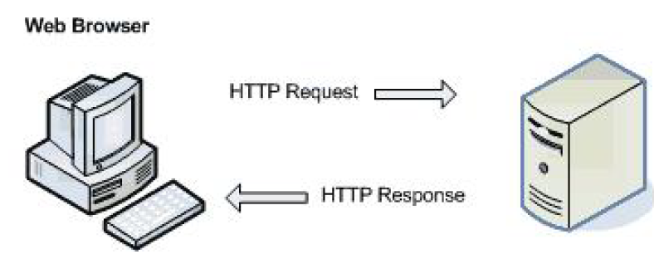
two-tier system.
The most basic architecture consisting of a client and a server.
Main responsibility of a server is data storage and processing capability.
The server acts as some database from which a client requests information.
Heavy processing takes place on the server.
Web browser is responsible for the display of web page to the client using a Graphical User Interface (GUI)
Web Server

Slide 17
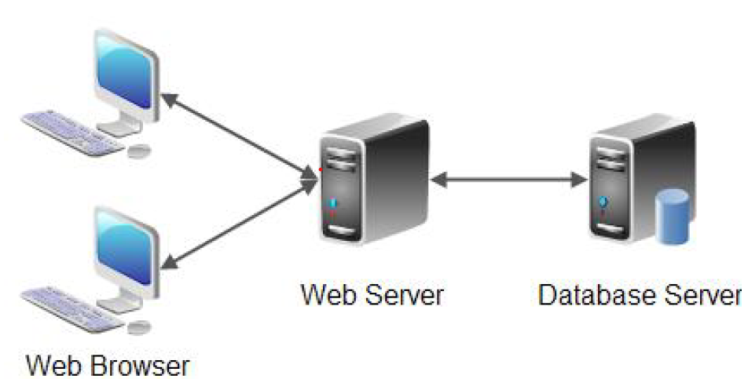
three-tier System.
As more servers are added, the client/server system evolves into a three-tier client/server architecture.
The web server is divided into two distinct entities
Processing tier (Web Server) and
Data storage tier (Database Server).
The processing tier is also known as middle tier and is responsible for handling the interaction between the client and the data storage tier.
The client tier makes a request for the database to a Web server by using the web browser.
The processing tier makes all necessary processing before the request is forwarded to the data storage tier for read or write operation.
The processing tier is then responsible for generating the response header and the database.

Slide 18
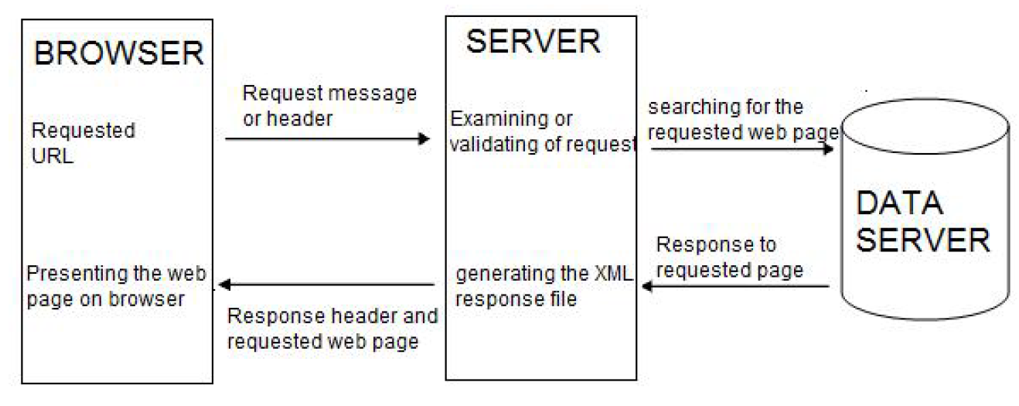
Communication protocol between a Browser and a Web Server

Slide 19
Advantages of client server architecture
Centralized data management
Allowing for easier data access and control.
Improved reliability
Through fault tolerance and load balancing mechanisms.
Enhanced security measures
Provides robust security features, safeguarding data and resources from unauthorized access.
Efficient resource utilization
By distributing tasks between clients and servers, leading to improved performance.
Easier maintenance and updates.
Changes can be implemented centrally on the server.
Seamless integration of new technologies
Ensures compatibility and scalability

Slide 20
Challenges and limitations of client-server architecture
Network congestions and single points of failure.
This can impact system performance and reliability.
Dependency on server availability and scalability limitations.
Is dependent on server availability, leading to potential downtime
May encounter scalability limitations as the number of clients increases.
Managing a large number of clients and ensuring consistent performance.
To manage a large number of clients effectively while ensuring consistent performance across varied user loads.
Addressing compatibility issues with diverse client devices.
Requires comprehensive testing and support for various platforms.

Slide 21
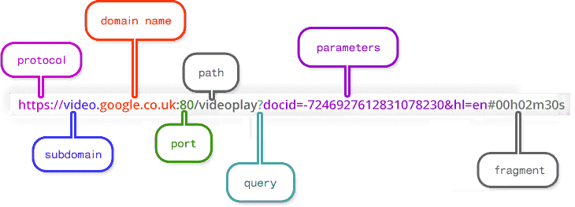
Uniform Resource Locator (URL)

Slide 22
Uniform Resource Locator (URL)
The complete address or location of the website (resource) we want to access.
Each website has a unique address.
Without specifying a valid URL, we cannot access a particular site.
Host Name: This is the domain name of the machine on which the resource lives.
Port Number: The port number to which to connect (optional).
Reference: A reference to a named anchor within a resource that usually identifies a specific location within a file (optional).
Protocol: The format of the resource depends entirely on the protocol used.
A URL is made up of the following components:
Filename: The pathname to the file on the machine.

Slide 23
Protocol
A protocol is a set of rules which enables a node of one network to communicate with a node of another network.
Examples of protocols
Transfer Control Protocol / Internet Protocol (TCP/IP)
Hyper-Text Transfer Protocol (HTTP)
Simple Mail Transfer Protocol (SMTP)
Point –to-Point Protocol (PPP)

Slide 24
Domain name
Are used in various networking contexts and addressing purposes.
Represents an Internet Protocol (IP) resource, such as a personal computer used to access the Internet or a server hosting a web site.
Provide an easily recognizable and memoizable names to the numerically addressed Internet resources.
Is used by an organizational entity to identify its website.
Each Internet address is translated into a series of numbers called an IP address.
Domain names are formed by the rules and procedures of the Domain Name System (DNS).

Slide 25
Domain Name Server
Nodes of the domain name system which are responsible for allotting names and mapping (translating) these names to IP addresses.
It is a hierarchical naming system built on a distributed database
Each domain has at least one authoritative DNS server that publishes information about that domain and the name servers of any domains subordinate to it.
The top of the hierarchy is served by the root nameservers.

Slide 26
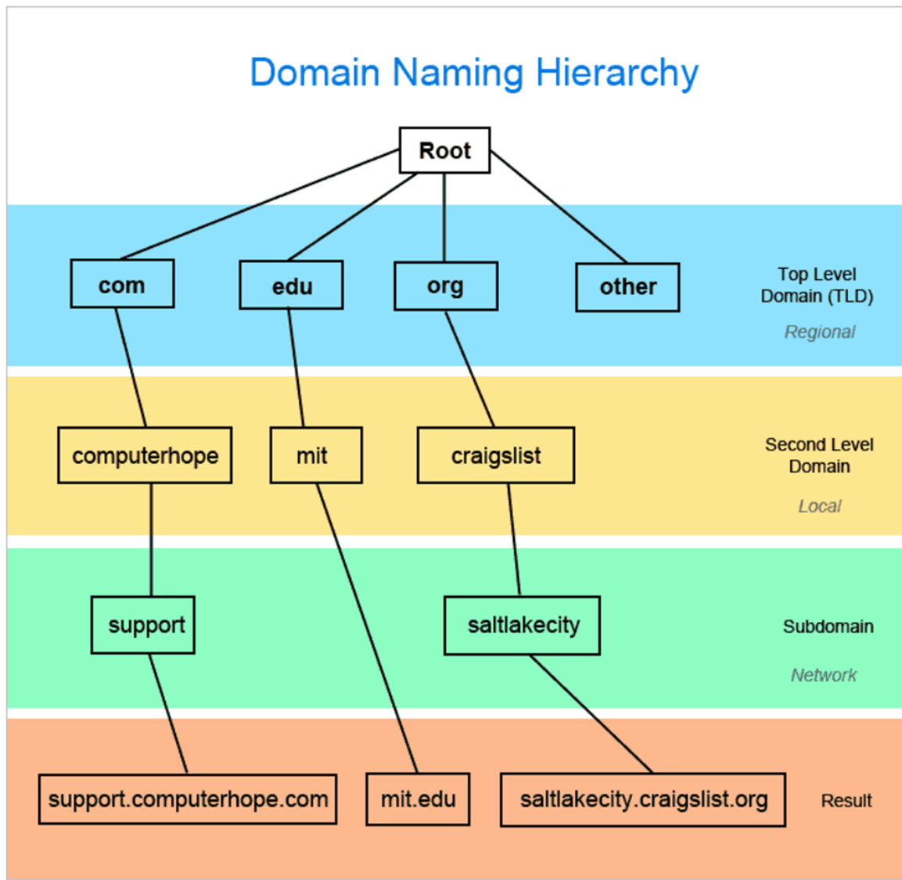
Dns hierarchy
Root Domain
Managed by Internet Assigned Numbers Authority (IANA)
Contain the authoritative name servers for all top-level domains.
Top-Level Domains (TLDs)
Include generic TLDs and country-code TLDs
Can further be categorized into various subgroups.
Second-Level Domains
Directly follow TLDs in the hierarchy.
Used to register unique domain names for organizations, businesses or individuals.
Subdomains
Subdivisions of a domain.
Provide a way to create unique web addresses for different sections of a website or for specific use cases

Slide 27
Dns resolution process
Querying DNS Servers
When a user enters a domain name (in the web browser), the DNS resolution process involves querying the DNS servers to map the domain name to its corresponding IP address.
Involvement of multiple servers
The process includes querying the recursive resolver, authoritative name server, and the root server if necessary.

Slide 28
Dns records
A Records (IPv4)
Maps domain names to IPv4 addresses
AAAA Records (Ipv6)
Maps domain names to IPv6 addresses
Cname Records
Creates aliases from one domain name to another
This is useful when you want to use multiple domain names to point to the same website or server.
MX Records
Identify mail servers responsible for receiving email on behalf of the domain
TXT Records
Stores text-based information associated with a domain

Slide 29
DNS performance optimization for better user experience.
Reducing DNS Lookup times.
Efforts taken to minimize the time taken for DNS lookups, enhancing overall performance.
Minimizing Latency
Strategies to decrease latency in DNS resolution processes for faster responses.
Implementing caching
Utilizing caching techniques to store DNS records locally, reducing query times for frequently accessed domains.
Utilizing Load Balancing
Deploying Load Balancing mechanisms to efficiently distribute DNS queries across multiple servers, optimizing performance.
Integrating Content Delivery Networks (CDNs)
Leveraging CDNs to distribute DNS contents geographically for improved speed and reliability of responses.

Slide 30
Challenges in dns management
Ensuring high availability.
Guaranteeing continuous availability of DNS services to prevent disruptions in network operations.
Maintaining accurate and up-to-date DNS records.
Ensuring the correctness and currency of DNS records despite dynamic changes in network environment.
Mitigating DNS-related attacks.
Implementing robust security measures to safeguard against DNS vulnerabilities and potential cyber threats.
Managing DNS configurations across distributed networks.
Efficiently handling DNS settings and configurations across geographically dispersed network infrastructures.

Slide 31
IP Address
Internet address follows the TCP/IP suite hence, it is also known as the IP address.
The basic function of IP address are
Identifying a device/node on the network.
Location addressing
IP address can be either static or dynamic.
Static IP address is persistent configuration (does not change when booting the node)
Dynamic IP address – a new IP address is assigned to the node each time.
Numerical label assigned to each device in a network

Slide 32
Uniform Resource Identifiers (Uri)
An important function of domain names is to provide easily recognizable and memoizable names to numerically addressed Internet resources.
This abstraction allows any resource to be moved to a different physical location.
Such a move usually requires changing the IP address of a resource and the corresponding translation of this IP address to and from its domain name.

Slide 33
Internet Service Provider (ISP)
A company that provides access to the Internet, hosts data, or does both through their server.
ISP is also known as (internet access provider)
Connect customers to the Internet using copper, wireless or fibre connections.
Hosting Services: lease server space for smaller businesses and host other servers.

Slide 34
Real Life Example – Trying to connect to www.google.com
A User opens a web browser and tries to connect to www.google.com. The operating system not knowing the IP Address for www.google.com, asks the ISP's DNS Server for this information.
The ISP's DNS Server does not know this information, so it connects to a Root Server to find out what name server, running somewhere in the world, know the information about google.com.
The Root Server tells the ISP's DNS Server to contact a particular name server that knows the information about google.com.
The ISP's DNS Server connects to Google's DNS server and asks for the IP Address for www.google.com.
Google's DNS Server responds to the ISP's DNS server with the appropriate IP Address.
The ISP's DNS Server tells the User's operating system the IP Address for google.com.
The operating system tells the Web Browser the IP Address for www.google.com.
The web browser connects and starts communication with www.google.com.

Slide 35
Page loading on the browser
The web browser then initiates a series of communication messages in order to fetch and display the information.
The domain-name portion of the URL is resolved into an IP address using the Domain Name System (DNS).
The browser then requests the resource by sending an HTTP request to the Web server at that particular address.
The HTML text of the page is requested first and parsed immediately by the web browser, which then makes additional requests for images and any other files of that page.
While receiving these files, browsers may progressively render the page onto the screen as specified by its HTML, Cascading Style Sheets (CSS), or other page composition languages.
Any images and other resources are incorporated to produce the onscreen web page that the user sees.
Most web pages contain a collection of useful, related resources, interconnected via hypertext links

Slide 36

Web programming
More than creating and formatting webpages and websites.
With the use of scripting languages such as JavaScript and PHP, it is possible to add a lot more functionalities to a web site to make it more interactive.

Slide 37
Web Pages
Web pages are what make up the World Wide Web.
Web pages are written in HTML (Hypertext Markup Language) and are translated by the Web browser.
Web pages can either be static or dynamic.
Static pages show the same content each time they are viewed.
Dynamic pages have content that:
Can change each time they are accessed.
These pages are typically written in scripting languages such as JavaScript, PHP, ASP, JSP, etc.
Some types of processing are applied either at client side (example, JavaScript) or server side (example, PHP, Perl, ASP, JSP, etc.).
Web page structure is made up of several components, which affects performance in terms of bandwidth consumption.

Slide 38

Contact details
parweznm@gmail.com
Mobile: 5905 4330

